Slide 1
Visual & Motor Integration During a Discrimination Task
Corollary Cormorants
Kai Park, Martina Acevedo, Dua Azhar, Megan Nelson, Armaan Raina
TAs: Benjie Miao, Younes Valibeigi

Slide 2
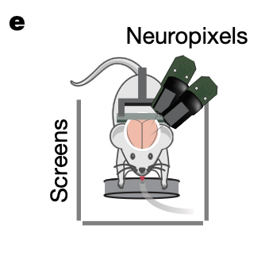
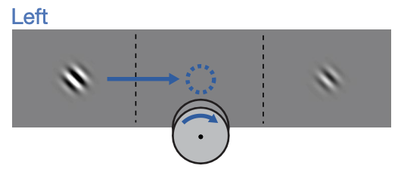
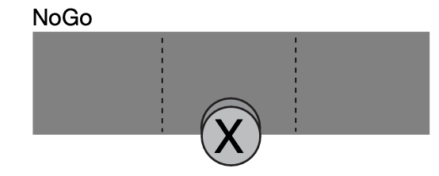
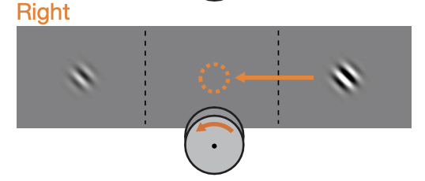
Introduction & Hypothesis
Introduction/Background:
Effective movement requires sensory-motor integration
Analysis based on Steinmetz et al.'s mouse visual discrimination task
Task engages both visual processing and motor control
Mice turn a wheel based on visual stimuli contrast
Task combines 2-alternative forced choice and go/no-go paradigms
Hypothesis and Analysis Aims:
Correlated activity between motor and visual cortices during decision-making predicts response.
Determine if these regions encode choice jointly or separately.
Study will illuminate potential integration of information between visual and motor areas for decision-making
Notes:
Kai and Megan
Sensorimotor integration is key for a moving organism to navigate and interact with its environment, as movements have sensory consequences
Steinmetz et al paradigm: mice have to turn wheel in direction of stimulus of greatest contrast vs. the bg
Non-naturalistic (learned) movement …
This task involves first visual processing of the stimulus, then integration with the motor system in order to execute the desired movement. We want to study the extent and nature of visuomotor connectivity

Slide 3
Methods Overview
01
Data Visualization, Preprocessing
Plot Peri-Stimulus Time Histogram (PSTH)
Binned spikes, and computing mean across selected timebins
PCA for visualization and dimensionality reduction
02
Nonlinear Decoder
Can we decode response from Primary Visual Cortex (VISp) and Secondary Motor Cortex (MOs)?
If we can decode, does the integration of both perform better than the individual areas?
03
Pearson Correlation/GCA
With correlation, how synchronized are the individual areas? And how well do they work together?
Using causality, can we determine the functional connectivity between the regions?
Notes:
Armaan
Preprocessing - slice neural data from time bins 50:100 (stimulus presented at 50) and get mean spike counts across those 50 bins
Exclude no-go trials, can we decode Left or Right response from vis and motor ctx?
Logistic regression - binary classification (L/R)
Throw in the formula
Deep Neural Network
Correlation between firing in vis and motor

Slide 4
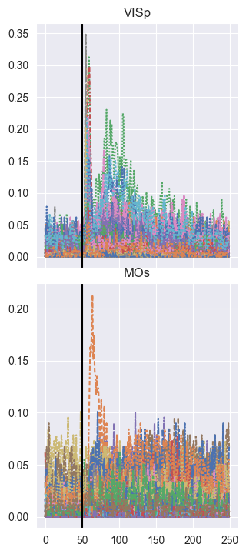
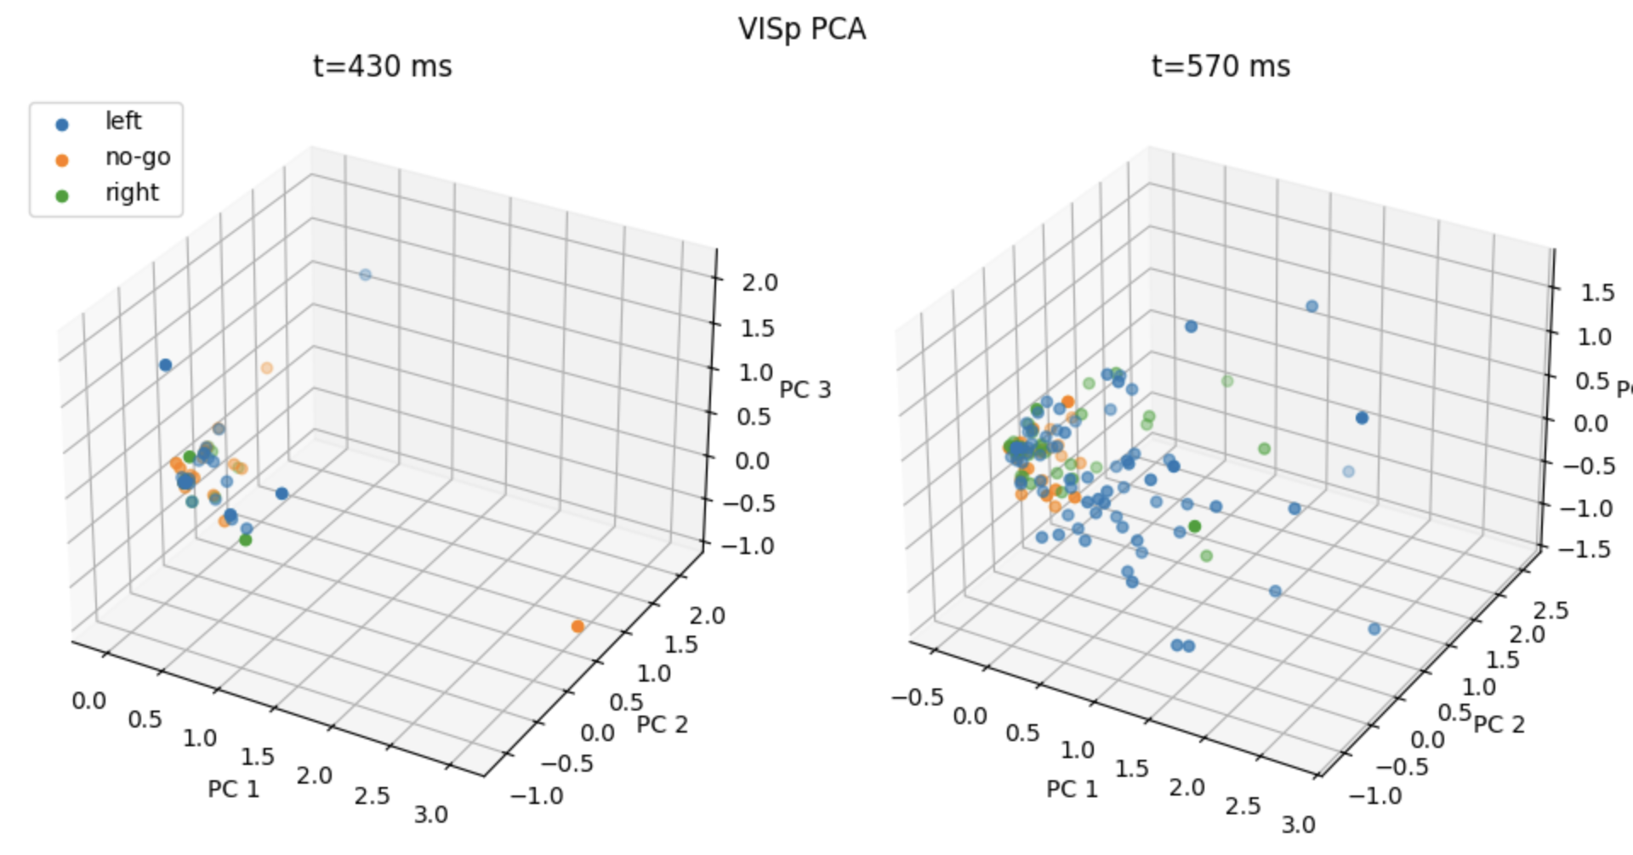
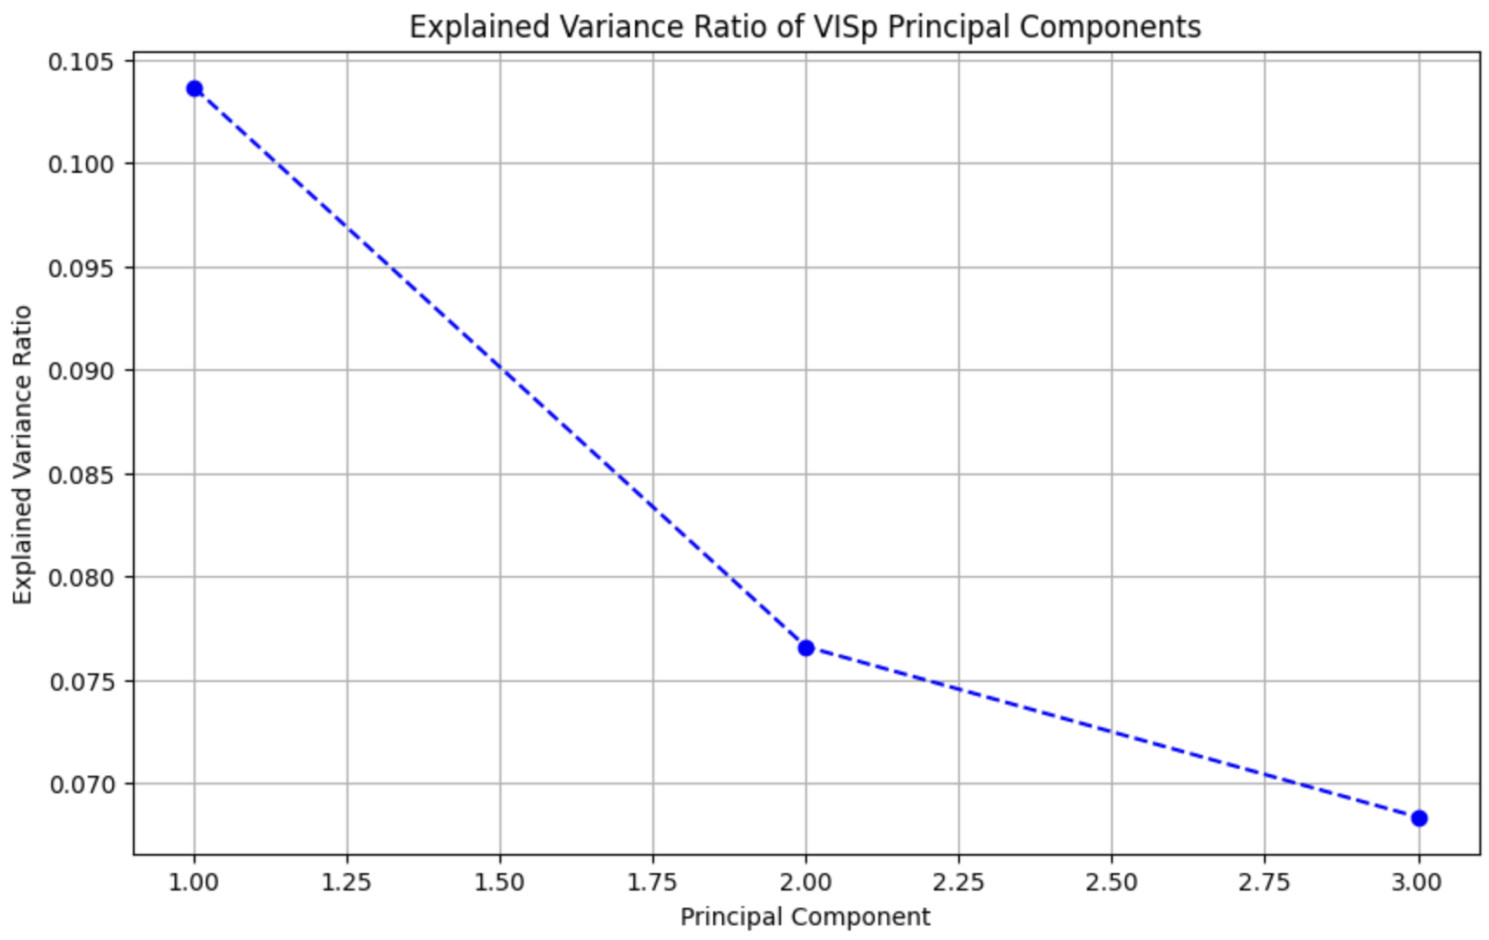
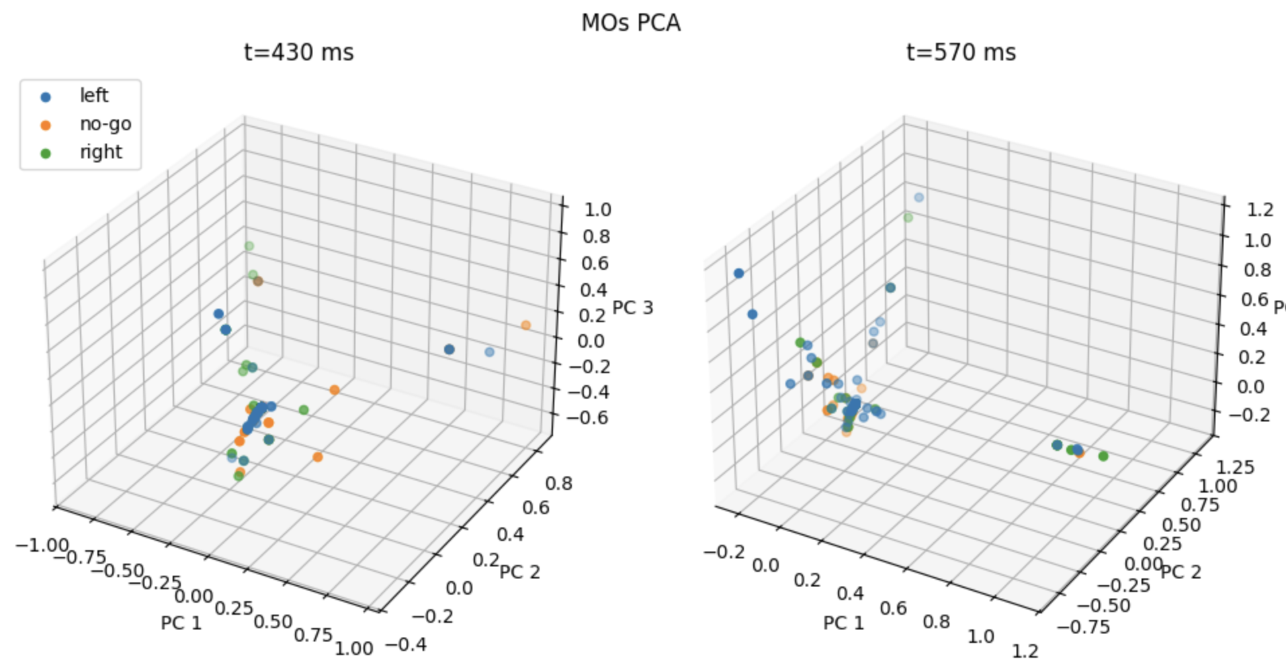
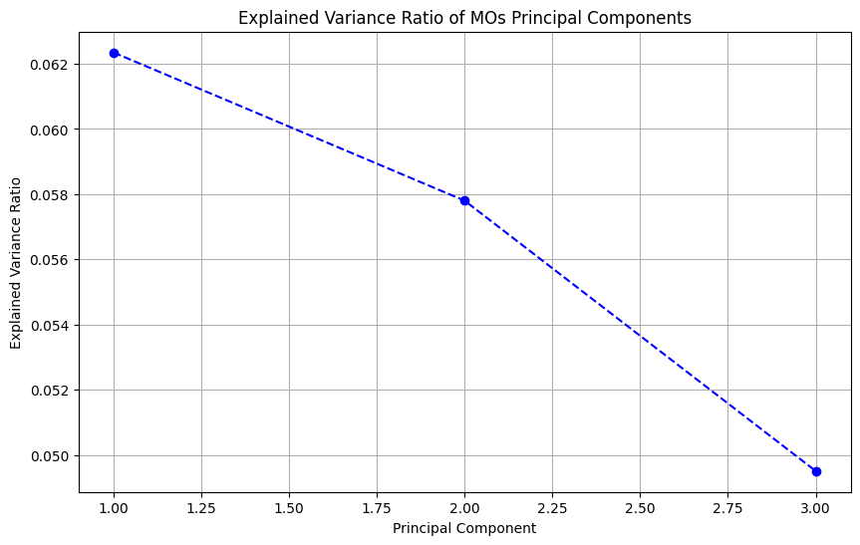
Visualizing the Data
PSTH: VISp and MOs neurons respond to stim
PCA: VISp and MOs neurons before and after stimulus (t_stim = 500 ms)
Explained Variance Ratio
Notes:
Kai
Selected dataset from session 25, as it contains data from both brain regions we are interested in.
MOs known for its role in cue-guided decision making
First plotted PSTH of spike data for both regions. Saw that bins 50-100 were relevant
3D plots of the first 3 principal components shows motif of neural responses when stimuli are presented

Slide 5
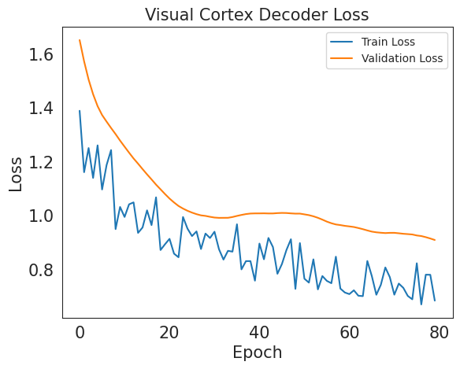
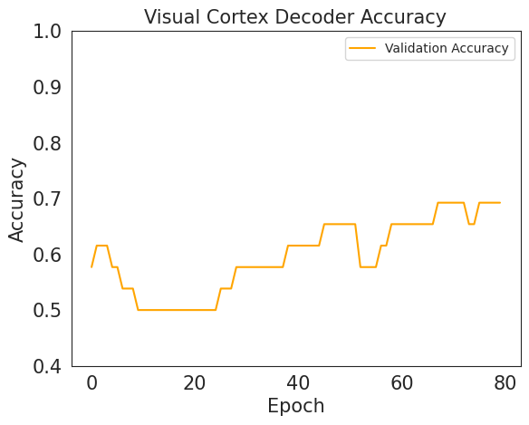
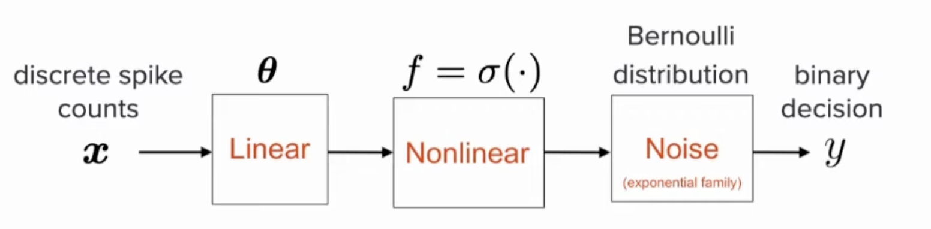
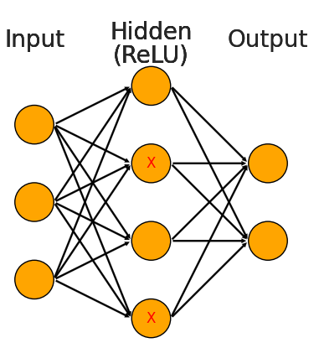
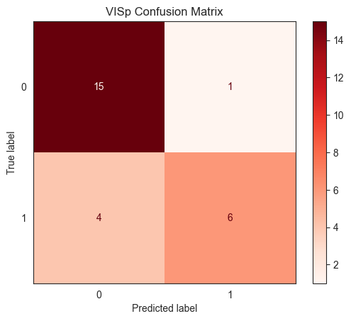
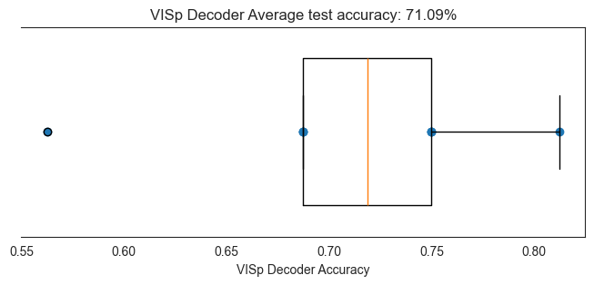
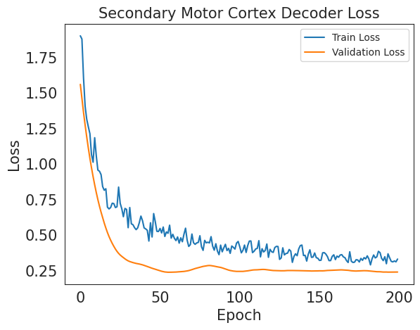
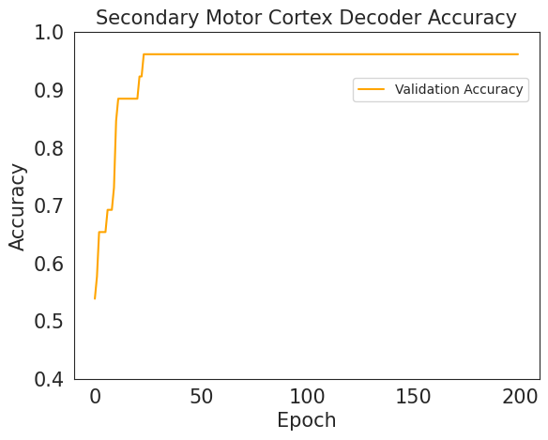
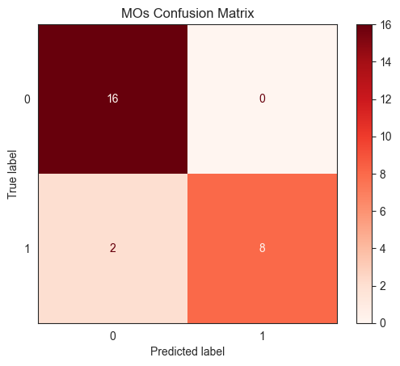
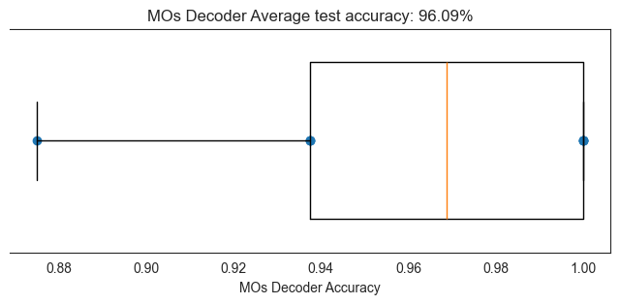
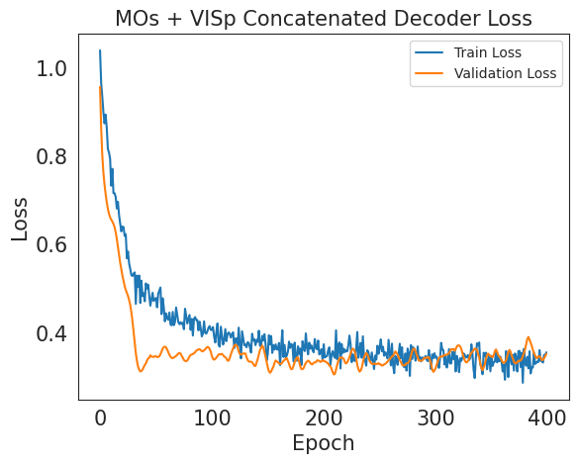
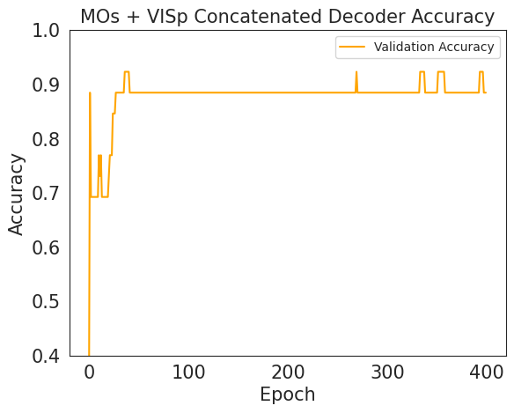
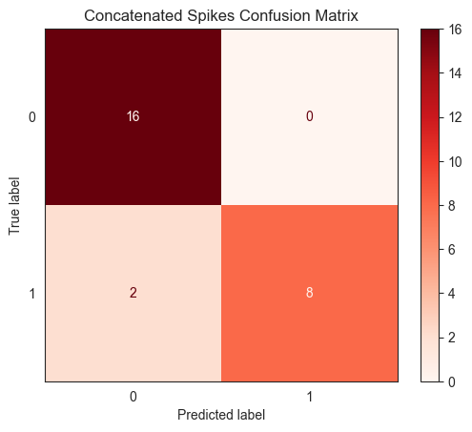
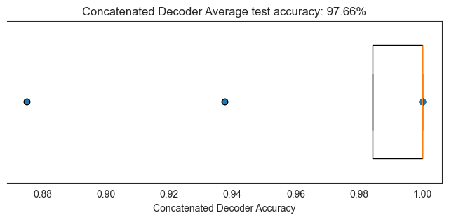
Decoding Results
Logistic Regression
Neural Network
Architecture:
Single Hidden Layer with ReLU activation.
Dropout Regularization to prevent overfitting.
Training Process:
Uses the Adam optimizer
Logistic Regression, with L2 penalty term, for binary prediction of left vs. right response from spike data (normalized firing rates over time bins containing stimulus onset). Model can predict accurately for motor and visual cortex, indicating that these regions likely encode response direction.
Achieved accuracies above 73% across all datasets,
with the MOs dataset demonstrating the highest performance.
Notes:
Kai and Martina
Logistic regression using SKLearn
Essentially a linear regression to predict probability, then the sigmoid link function maps these probabilities onto 2 (binary) classes to discretize them.
L2 punishes large coefficients
First filtered out ‘no-go’ trials, so we have binary decision making targets. Inputs were normalized firing rates, averaged over time bins 50-100 (500-1000 ms, starting from stimulus presentation)
Confusion matrix: diagonal shows correct predictions, false positives and false negatives are on the off diag
Used k=8 x val, mean accuracy was highest for motor and concatenated vis+motor data, lowest for visual data which intuitively makes sense given we are trying to decode response direction (wheel motion)
Wanted to test for involvement of the regions in the decision made
Also wanted to test for any nonlinear relationship, especially when utilizing both VISp and MOs together
due to similar performance of both decoders, relationship = linear

Slide 6
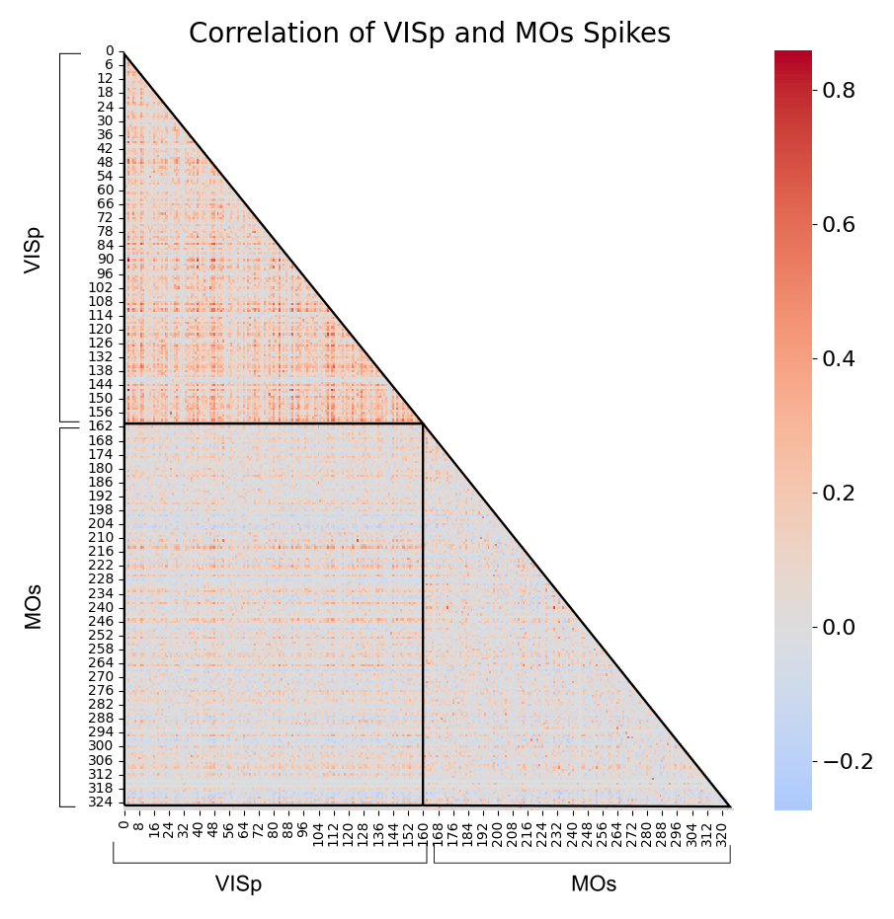
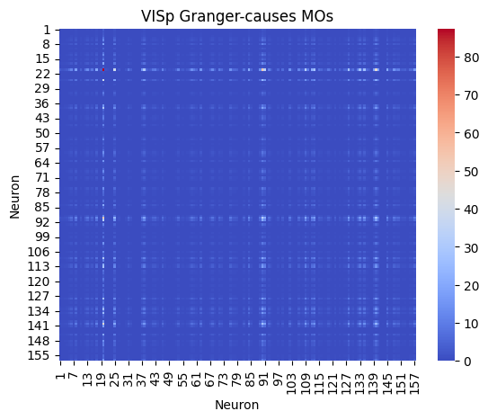
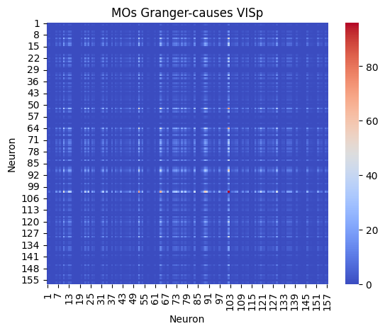
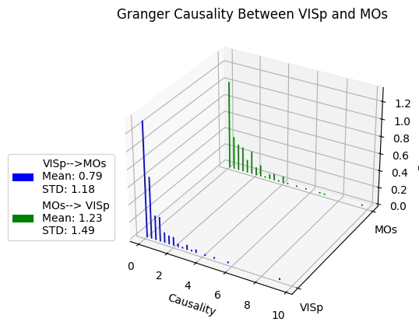
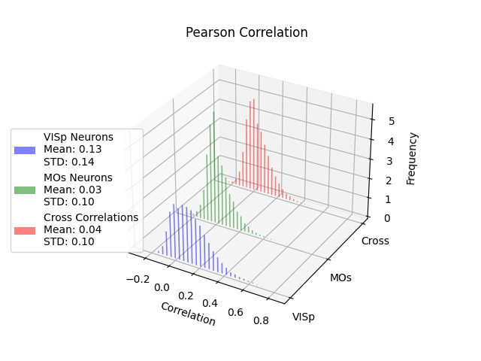
Pearson Correlation and Granger Causality Analysis
Higher correlations between pairs of VISp neurons
MOs-VISp correlations are low on average but show a long tail
Low causality between the two populations, but individual MOs cause VISp more than vice-versa, suggesting functional connectivity on the individual level.
Notes:
Martina and Dua

Slide 7
Conclusion & Future Steps
Conclusions:
MOs are more involved in decision, which corresponds to their role in planning and executing movement.
Along with concatenated decoder result, correlation confirms sensory-motor integration. Suggests a hierarchical processing of input to output.
Causality suggests there may be a top-down influence of MOs to VISp, possibly indicating motor predictive coding and visual sensory enhancement.
Limitations:
Only considering a subset of neurons.
Other confounding variables (input from other neurons, etc.) are not considered.
Future Steps:
Assess correlation and perform GCA on regions potentially involved in decision-making (i.e. basal ganglia).
Predict trial outcome against visual-motor correlation.
Incorporate memory in sensory-motor decision making by exploring Bayesian inference approaches
We would like to thank our NMA mentors Benjie and Younes and the Steinmetz team for the dataset!
Notes:
Dua
Possibility of another region (i.e. PFC, OFC) that is driving both MOs/VISp activity
Implement instruments, bias

